Slide 1


Puzzle game
Arduino project BY CESAR NIETO GONZALEZ

Slide 2
Puzzle Game
Introduction
Game video
About the code

Slide 3
INTRODUCTION
This Arduino-based sliding puzzle game involves manipulating tiles on an LCD screen to achieve a winning configuration. Users interact via UART commands, enjoying a dynamic and restartable gaming experience, showcasing Arduino's versatility in interactive applications. The game integrates hardware functionalities and engages players in a challenging yet entertaining puzzle-solving endeavor.

Slide 4
GAME VIDEO

Slide 5
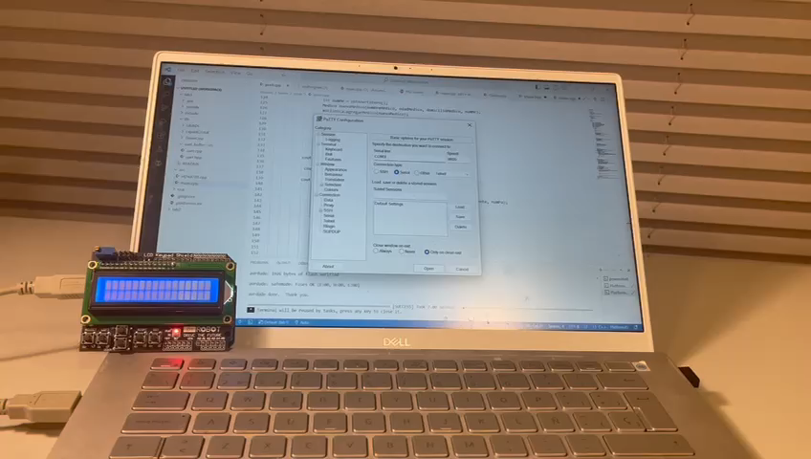

Slide 6
FUNCTIONS
1. `moveTile(char direction)`: Facilitates tile movement based on directional commands, updating the puzzle board accordingly.
2. `isGameComplete()`: Verifies if the puzzle is in a winning configuration, enhancing user experience.
3. `initializePuzzleBoard()`: Sets up the puzzle board with a predefined initial configuration for the game.
4. `generateRandomBoard()`: Randomly generates an initial puzzle board configuration, fostering variability.
5. Main Loop: Orchestrates the game's core functionality, managing user input, updating the display, and handling victory conditions.
6. Victory Handling and Restart: Displays a victory message, awaits user input, and restarts the game with a fresh configuration upon completion.

Slide 7

THE END

